Slide 1



RAJEEV INSTITUTE OF TECHNOLOGY
HASSAN
DEPARTMENT OF COMPUTER SCIENCE AND ENGINEERING
DBMS MINI PROJECT ON “FACULTY FEEDBACK SYSTEM”
Under the Guidance of Submitted by:
Mrs. MONIKA MM SURAJ R - 4RA21CS097 ASSISTANT PROFESSOR,
DEPT OF CSE, RIT HASSAN.

Slide 2
CONTENTS
ABSTRACT
INTRODUCTION
OBJECTIVES
SYSTEM AND SOFTWARE REQUIREMENTS
SNAPSHOTS

Slide 3
ABSTRACT
Faculty Feedback System is to provide feedback in an easy and quick manner to the college faculty. It is an interface between students and management for collecting feedback online.
By using this technology we can take feedback about the faculty by students fast and submit the same on time to head of departments as it is an online system. This project has two kinds of users Student, Administrator.
The student can give feedback in online system provided by college staff. First of all Administrator can prepare questions & add, update these questions to the online system. Those questions are viewed and answered by the students. These answers will be the feedback on that faculty individually.
Each individual feedback is taken and consolidated as a report. This feedback report is used by the HODs to check the performance.

Slide 4
INTRODUCTION
This project is about collecting feedback about the faculty from students effectively and in an easy way.
FEEDBACK from customer/ client/ student/ user is the only way to develop the organization. In general organizations collect feedback from its clients to improve their services based on given feedback and suggestions.
In case of educational institutions, it is mandatory to take feedback about the teaching staff so as to improve their standards of teaching. This feedback will help in internal improvement of standards and also external growth of the organization.
This is because if we respond properly for the feedback and take some measures then the quality of education will be improved which will improve the placements, sponsorships, etc. So for an educational institution, taking feedback is an important thing.

Slide 5
SIGNIFICANCE OF TECHNOLOGIES USED
HTML: defines the content and structure of web page.
CSS: Beautify the page layout by adding styles.
JAVASCRIPT: To add functions to code.
MYSQL: Language used to insert, delete, update data in database.
PHP: A server scripting language, and a powerful tool for making dynamic and interactive Web pages.

Slide 6
OBJECTIVES
Data Management: Design a database schema to efficiently store faculty information, feedback forms, responses, and any other relevant data.
User Interface: Develop an intuitive user interface for both faculty members and students to submit and access feedback.
Authentication and Authorization: Implement secure login systems for faculty and students, ensuring that only authorized users can access the system and their respective functionalities.
Feedback Forms: Design customizable feedback forms that can be tailored to different courses, departments, or faculty members.
Feedback Submission: Enable students to easily submit feedback for faculty members, including options for anonymous feedback if desired.
Data Analysis: Implement tools for analyzing feedback data, such as generating reports, visualizations, and statistical summaries to help faculty members identify areas for improvement.

Slide 7
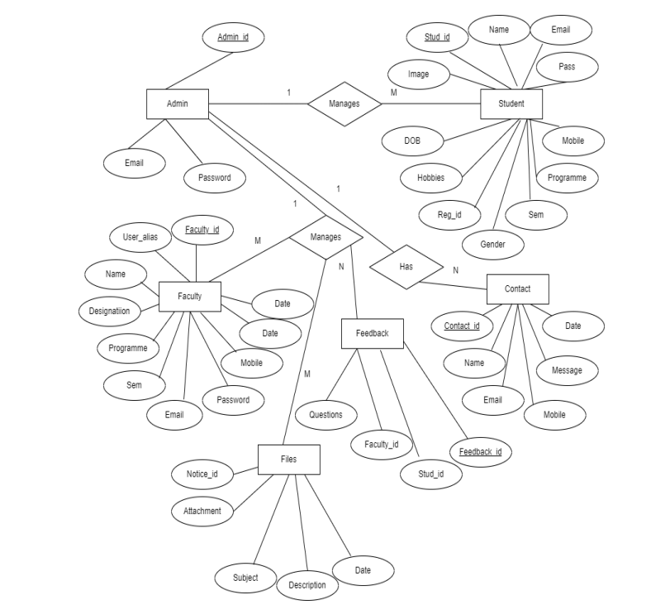
E-R DIAGRAM

Slide 8
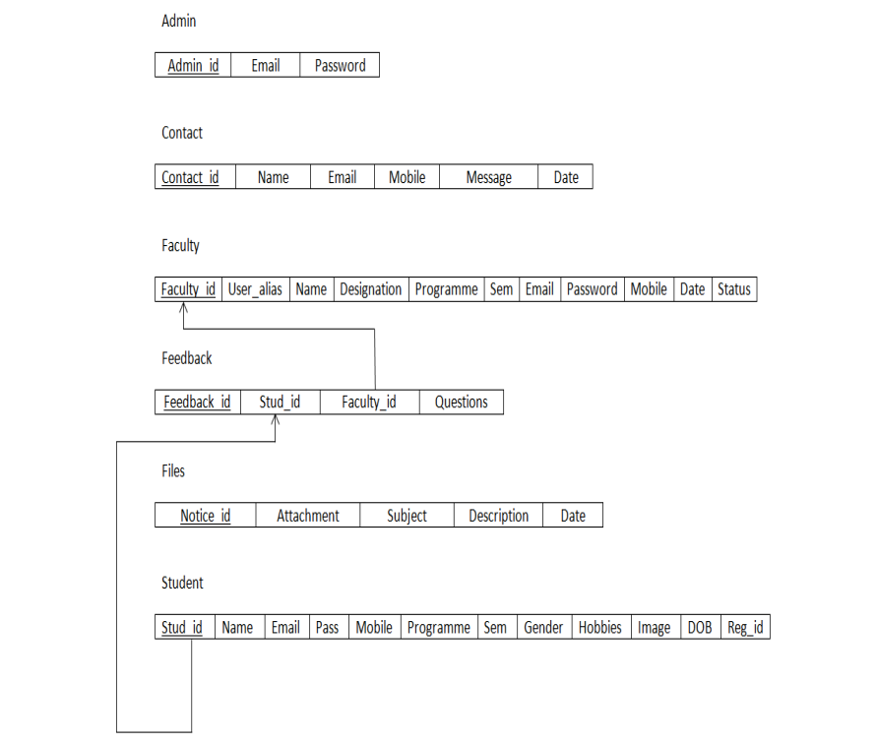
SCHEMA DIAGRAM

Slide 9
SYSTEM AND SOFTWARE REQUIREMENTS
SOFTWARE
OPERATING SYSTEM : WINDOWS
APPLICATION USED : PHP AND MYSQL
DATA BASE SERVER : LOCAL HOST
FRONT END : HTML AND CSS
BACK END : SQL SERVER
LANGUAGE : PHP
HARDWARE
PROCESSOR : 1.90 GHz PROCESSOR
RAM : 8.00 GB
HARD DISK : 1TB HARD DRIVE OR MORE
OPERATING SYSTEM : 7,8,8.1,10,11

Slide 10


Slide 11
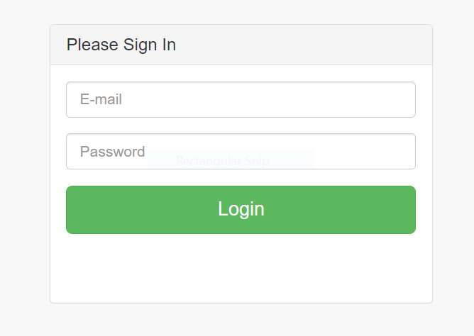
ADMIN LOGIN

Slide 12
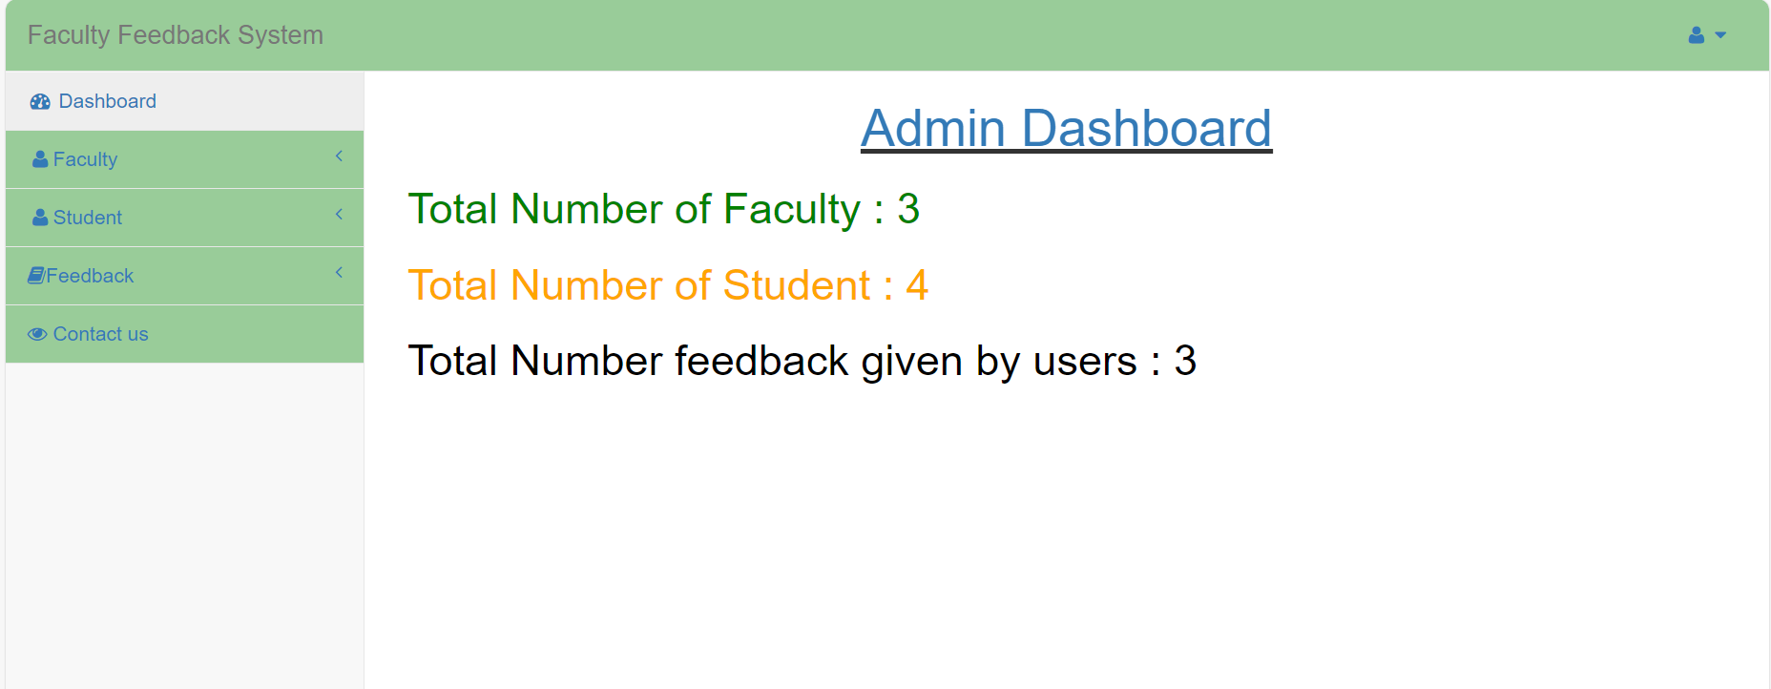

Slide 13
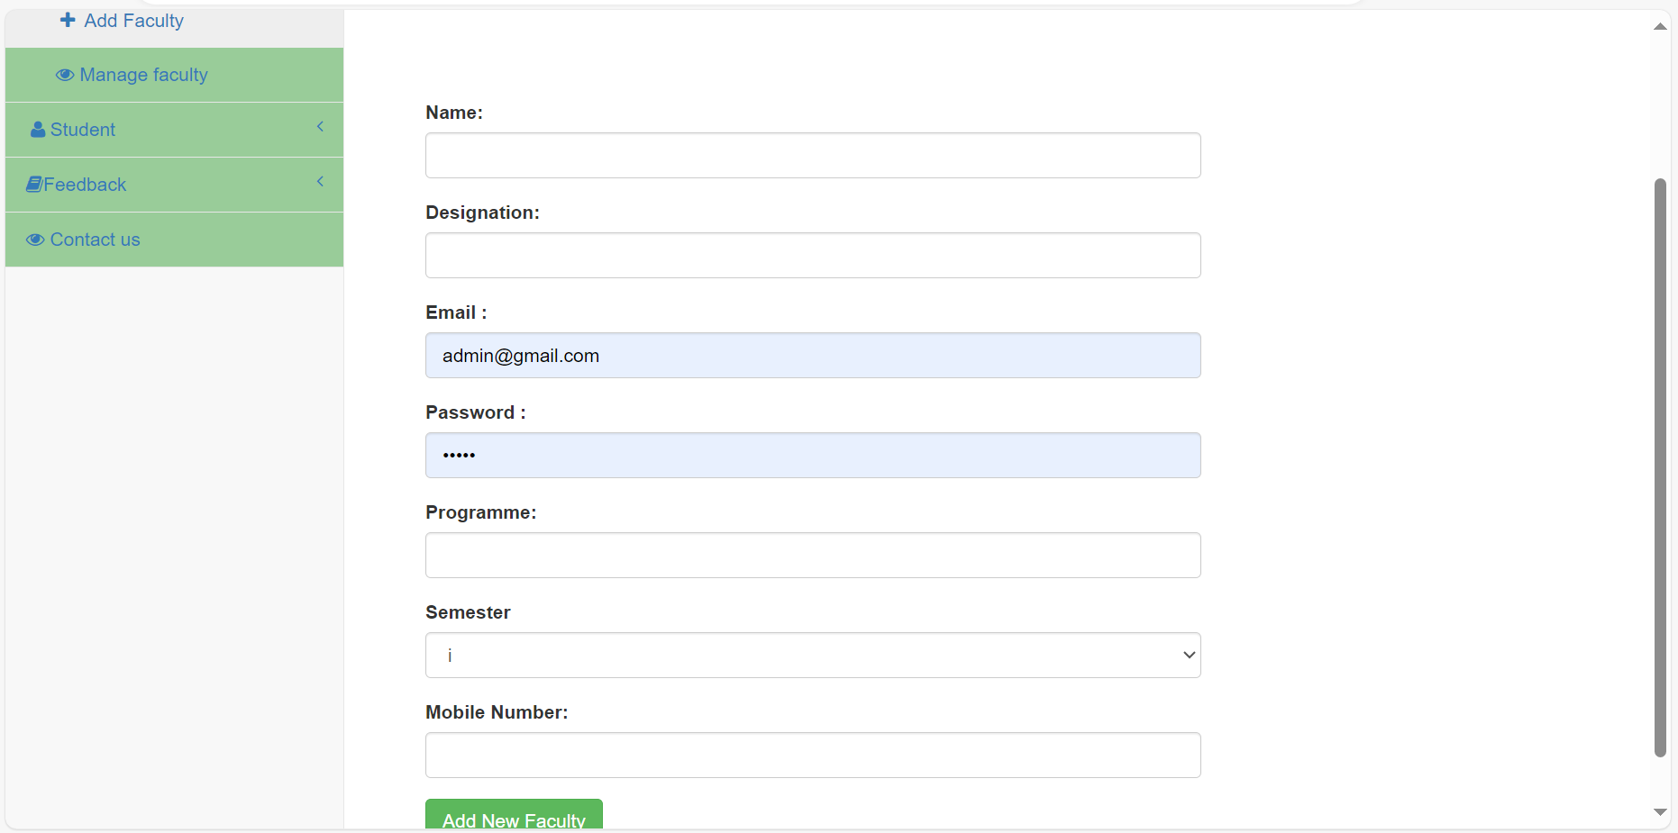
Admin can add and manage faculty.

Slide 14
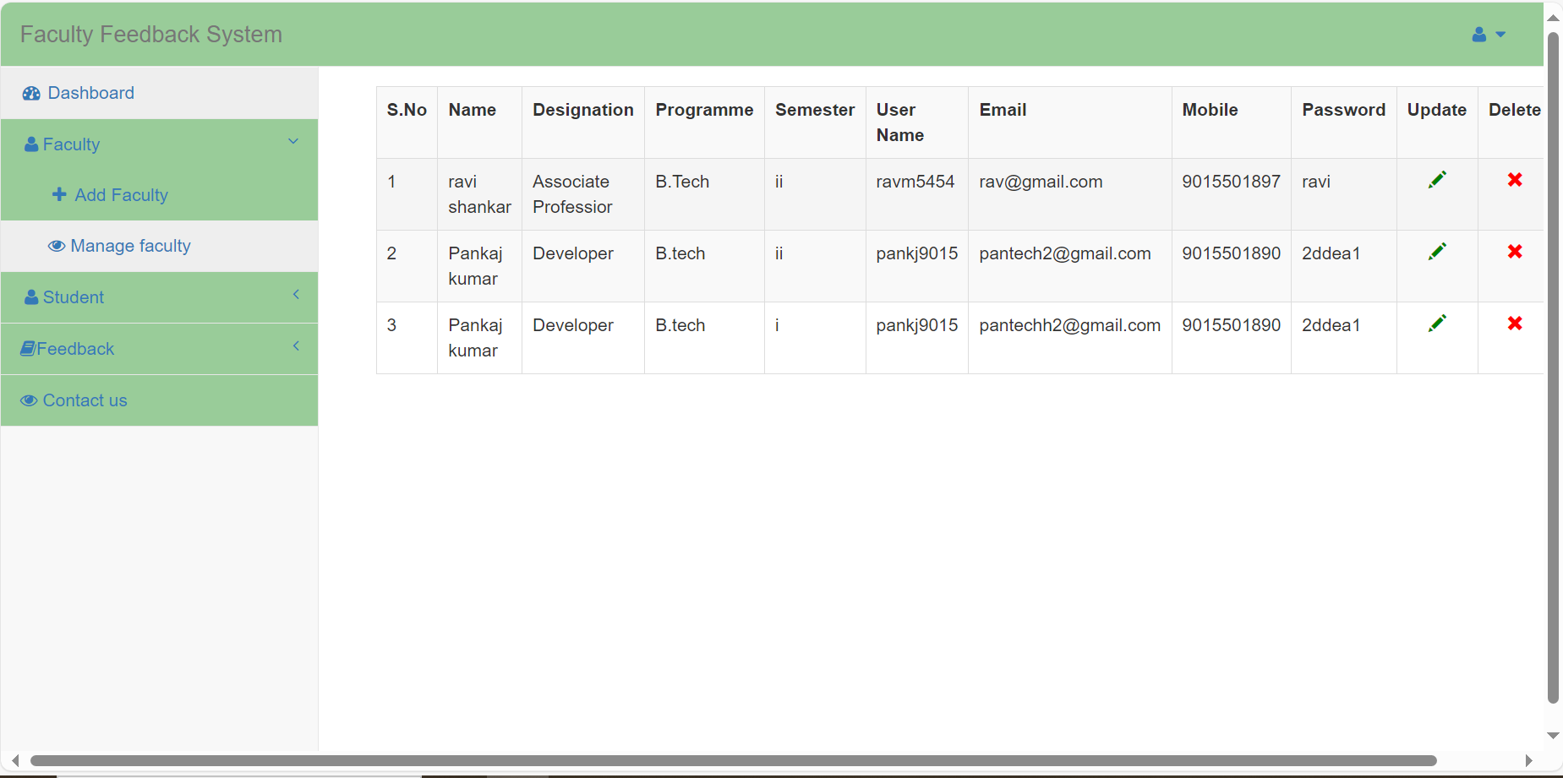

Slide 15
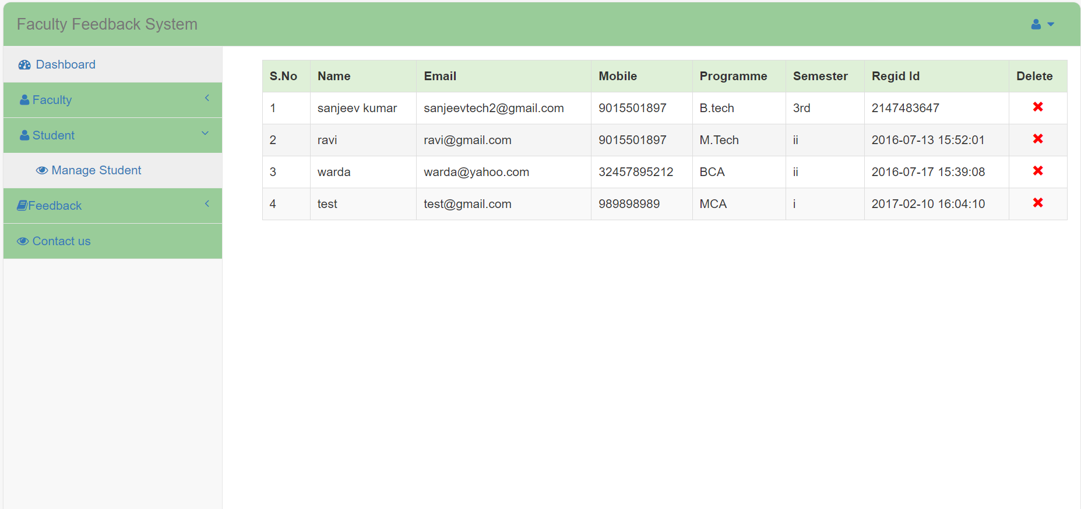
Admin can also manage student .

Slide 16
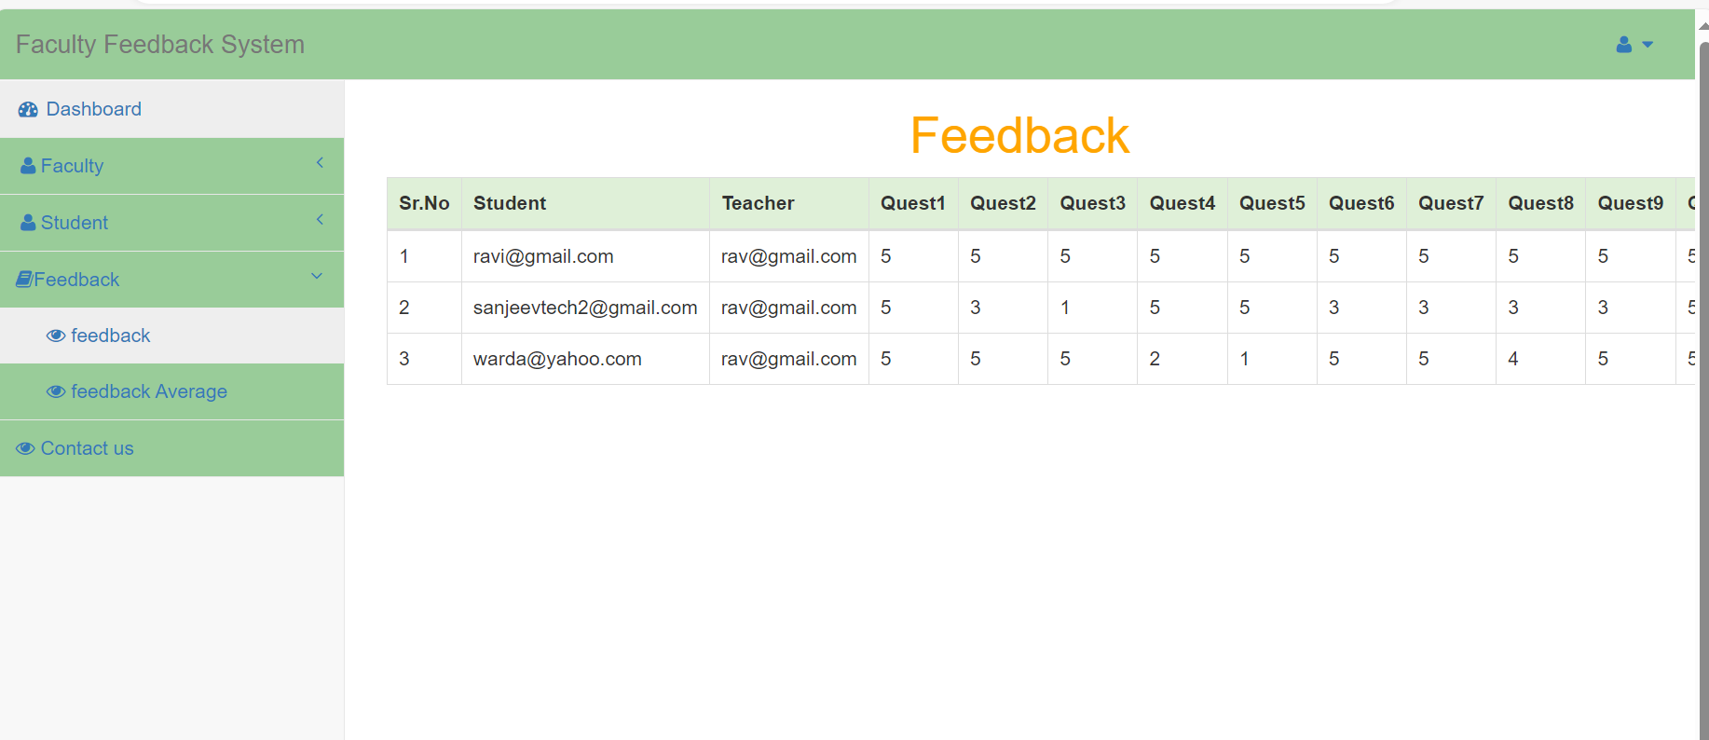
Admin can view the feedback given by the students.

Slide 17
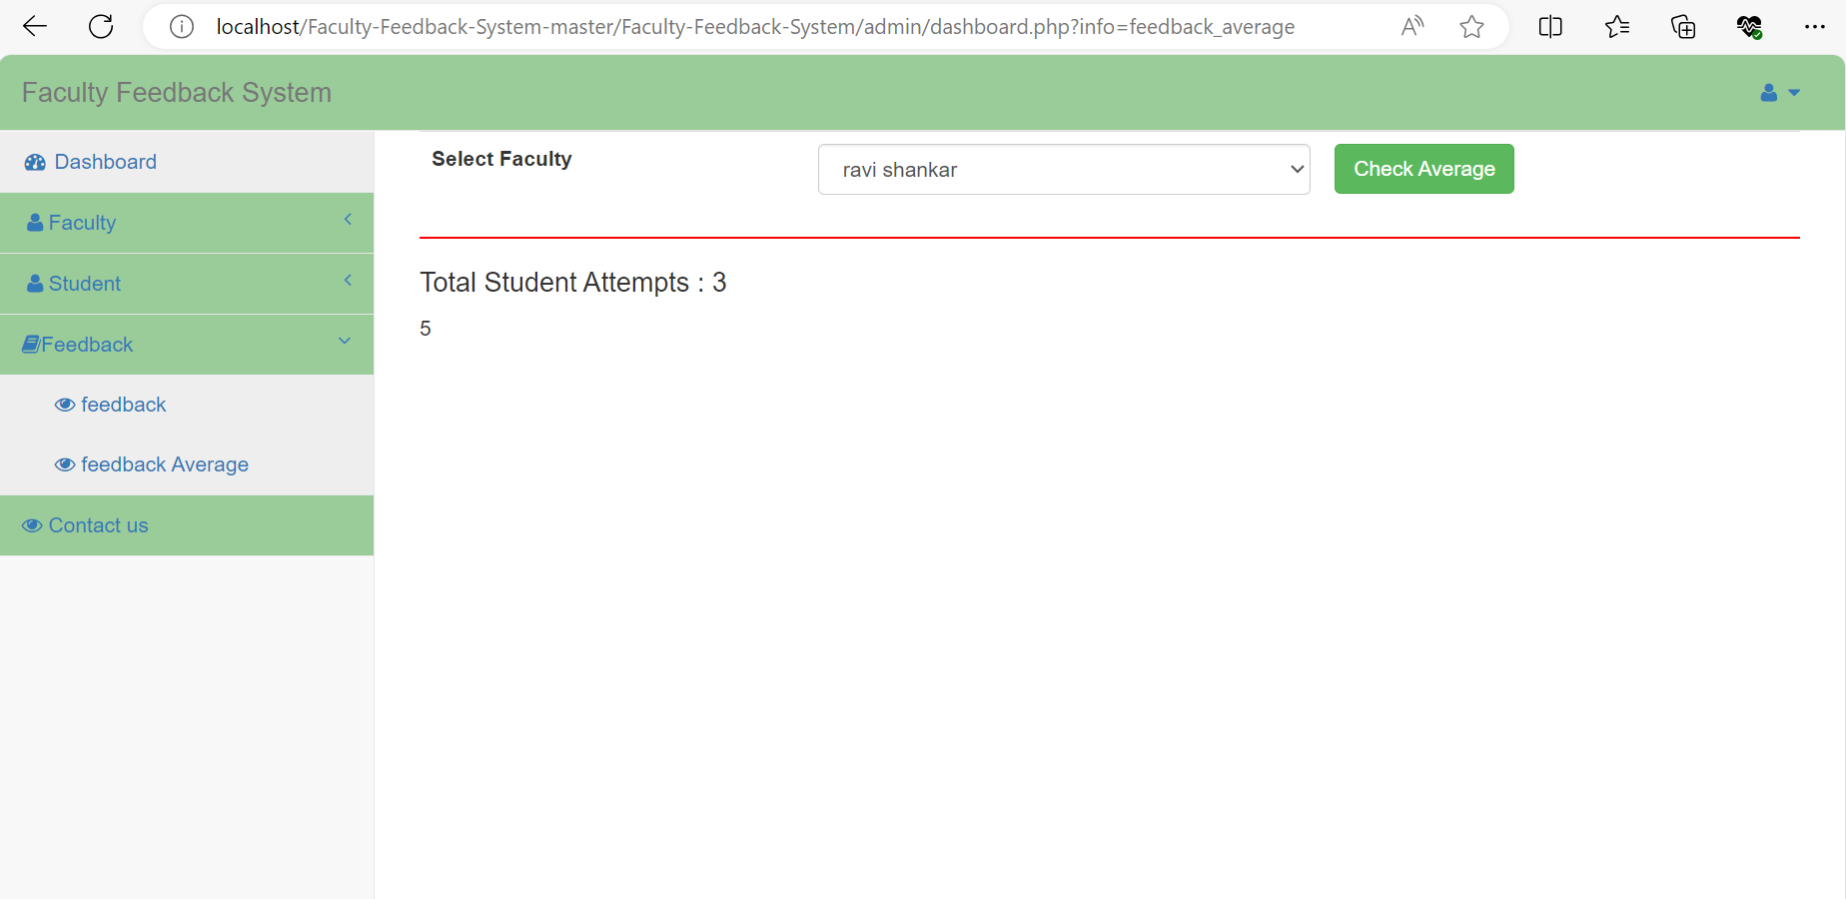
Admin can view student’s feedback average.

Slide 18
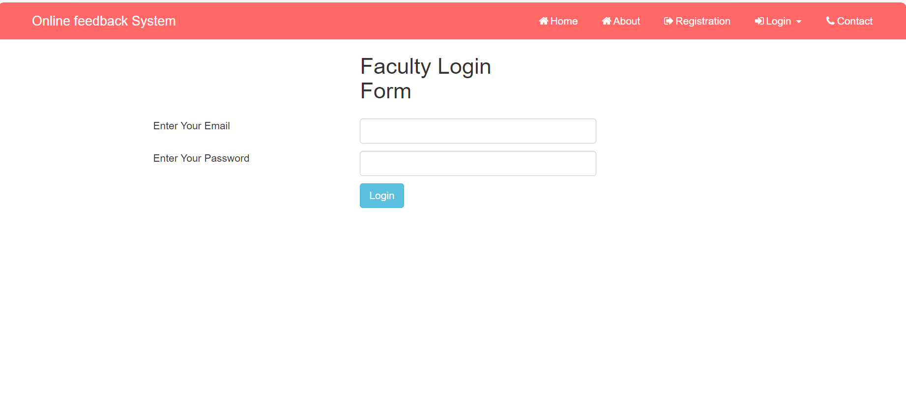
FACULTY LOGIN

Slide 19
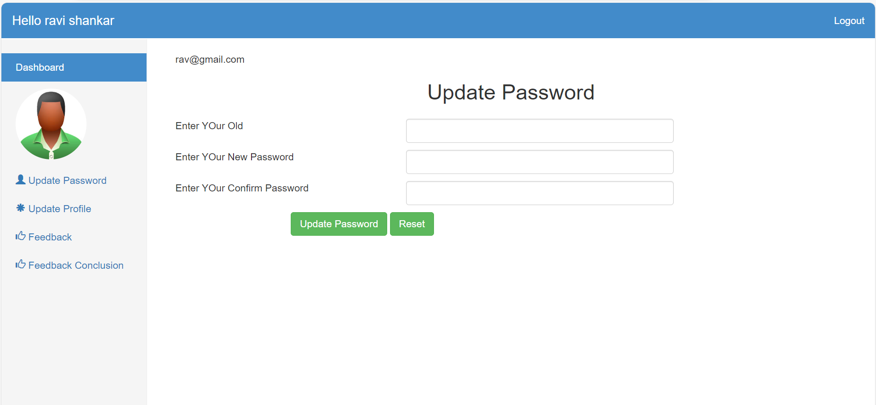
Faculty can update their password and profile.

Slide 20
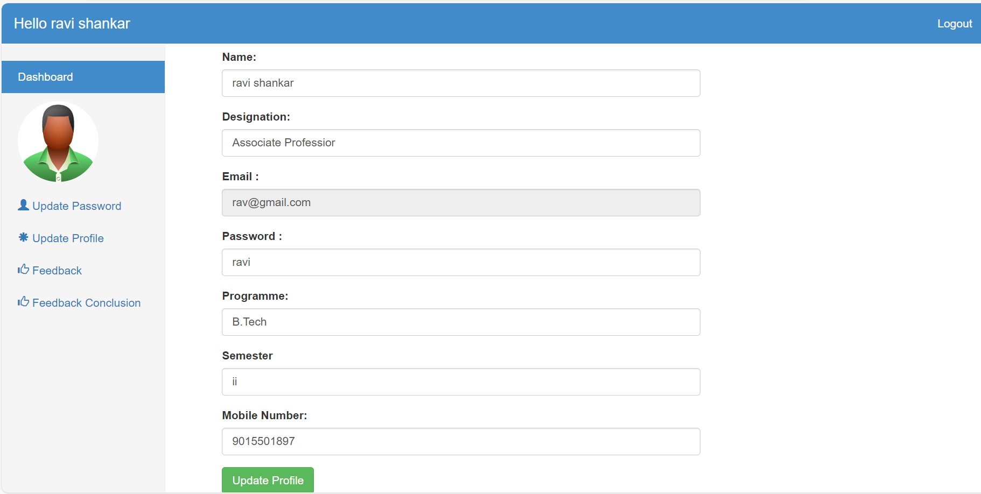

Slide 21
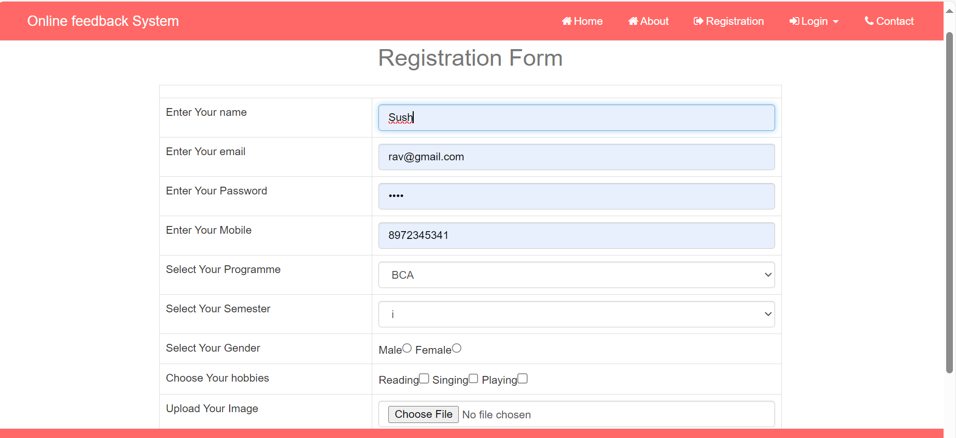
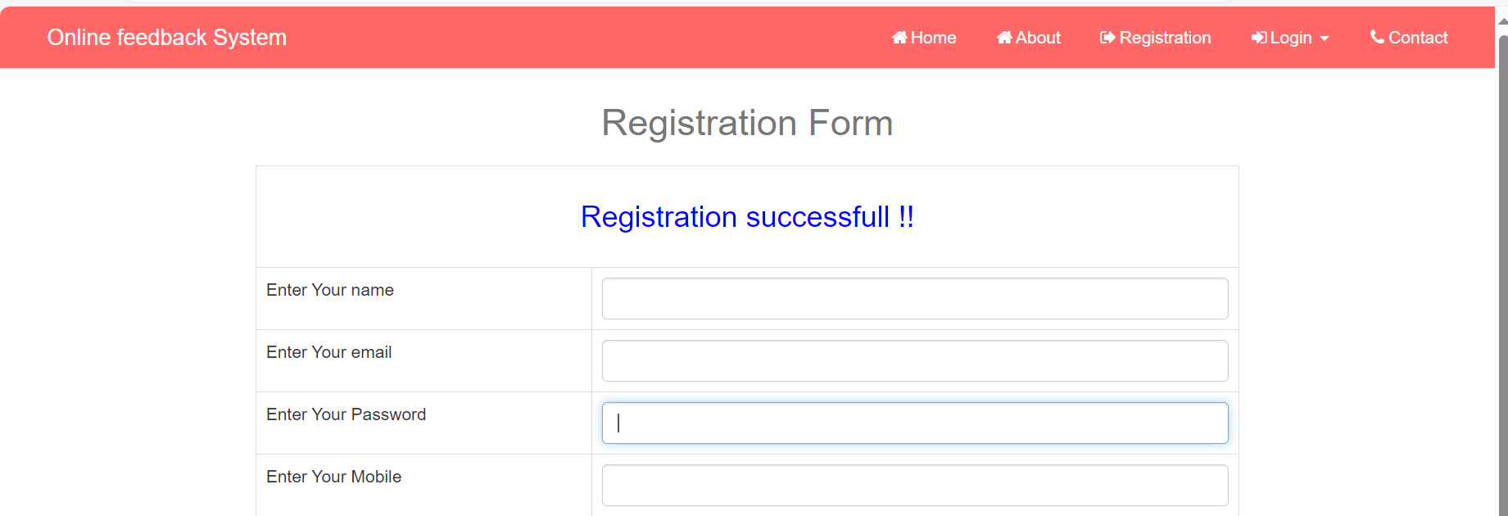
REGISTRATION FORM FOR STUDENTS

Slide 22

STUDENT LOGIN

Slide 23
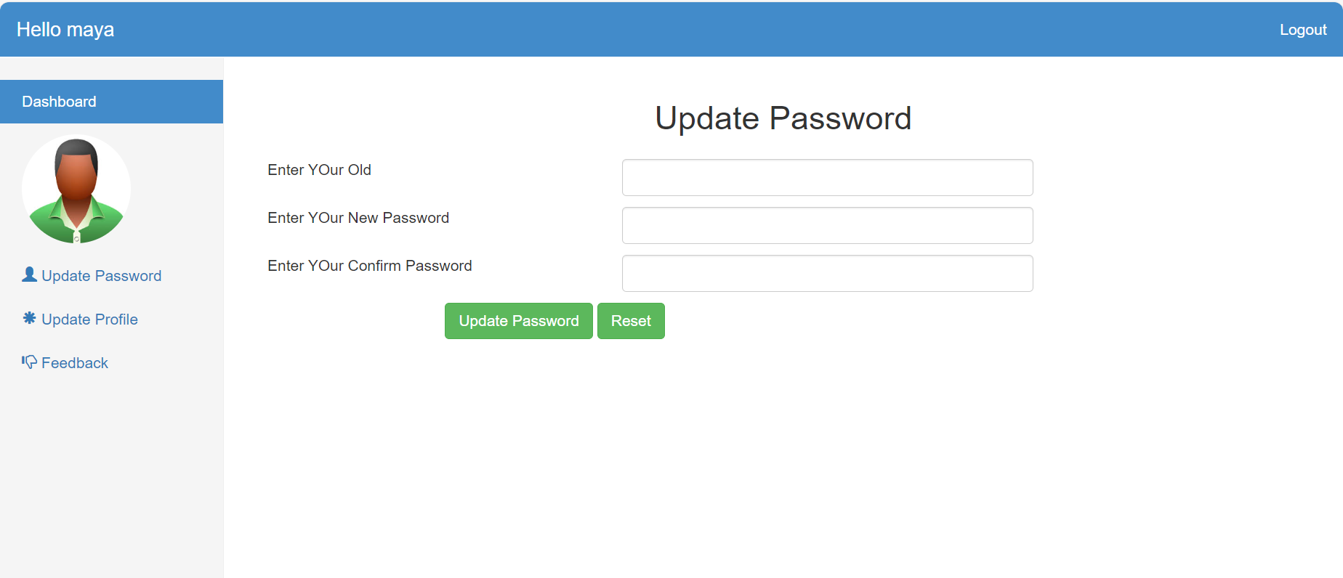
Students can update their password and profile and can also give feedback for faculty.

Slide 24
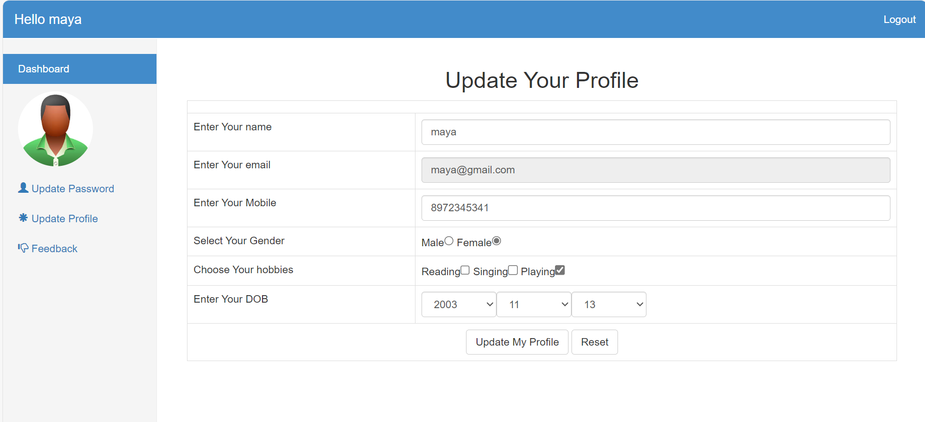

Slide 25
THANK YOU!!!!!!

